Slide 1

Hop or not to hop.
Our scenario – a runner running a track
Power received (RSSI)
Fading (Deep, slow and fast)
Energy measurements
Protocol (To hop or not to hop)

Slide 2
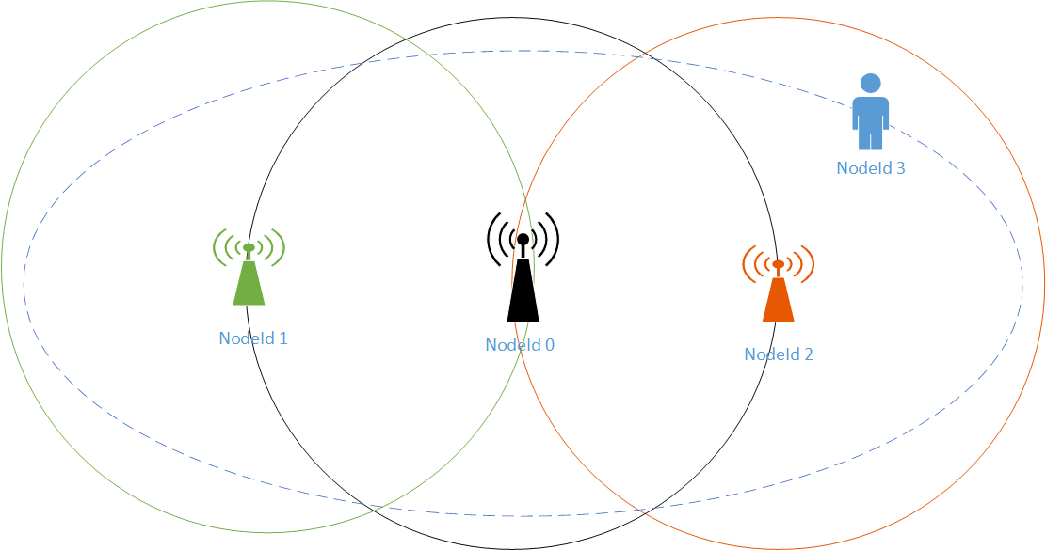
Scenario
Get runner’s pulse
Talk directly when possible
Use relays to extent track coverage
Simple relay
RSSI relay

Slide 3
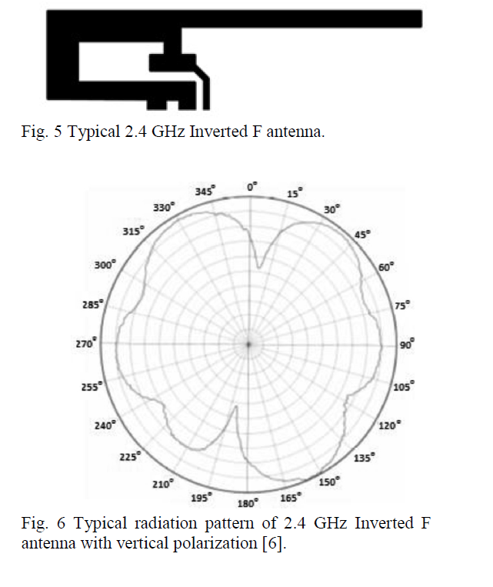
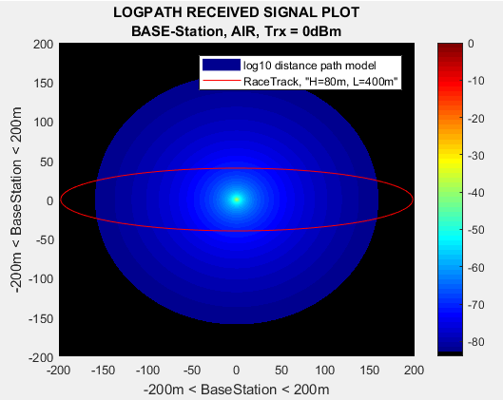
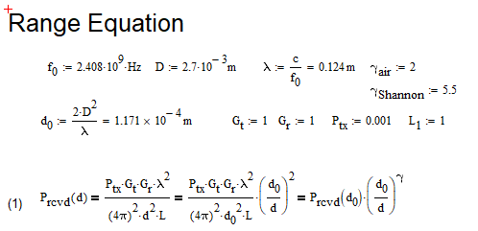
Base Station RSSI Log plots dBm
Environment: Interference free clean AIR
Ptx = 0dBm “1mW”
Isotropic Antenna
2.407GHz “ch1”
Lambda = v/f
2.7cm
d0=0.01167
-84dBm at 159.3m
Euclidian distance
-94dBm from datasheet

Slide 4
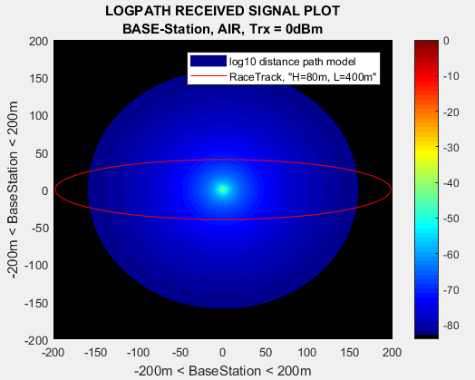
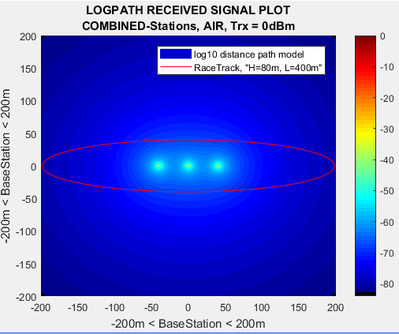
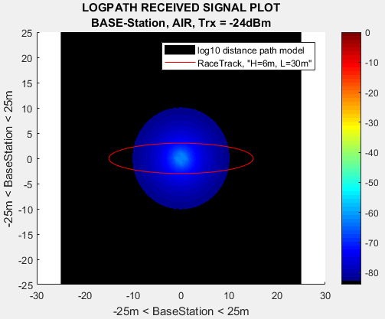

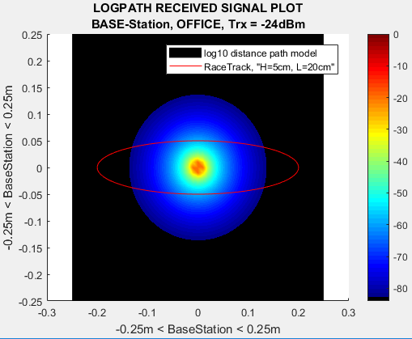
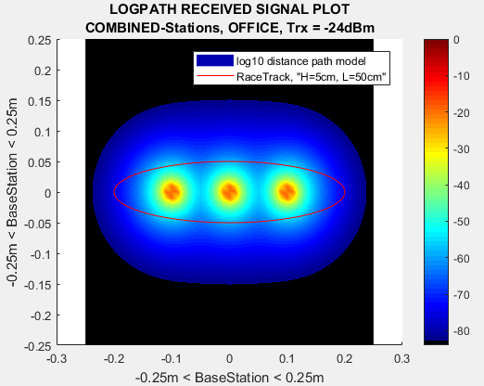
0dBm vs -24dBm & Air vs Building
Change in transmit power
0dBm_AIR Track “159.3m”
L400m, H=80m
-24dBm_AIR Track “10.1m”
L30m, H=6m
Reduced to 7.5% range
0dBm_Building Track “64.5m”
L30m, H=6m
Reduced to 32.25% range
-24dBm_Building Track “13.1cm”
L20cm, H=4m
Reduced to 0.035% range

Slide 5
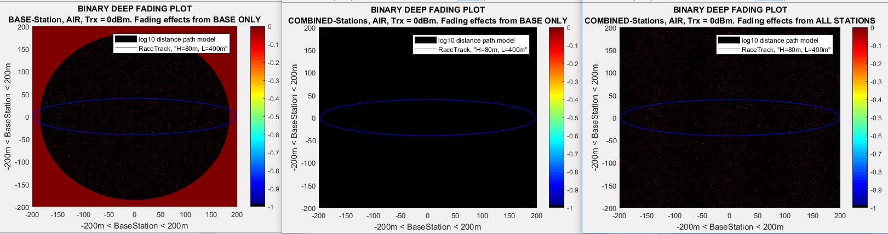
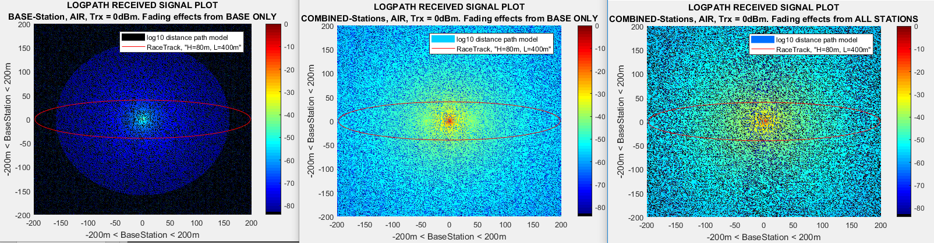
RSSI Fading
Reflection “Fast Fading”
2.4GHz => Lambda = 12.5cm
Destructive interference “Busty Errors”
-60dBm to -70dBm
In the range of tens to hundreds of milliseconds
Simulated as 250ms occurrences
Diffraction and Scattering “Slow Fading”
Shadowing effect “obstacles in the environment”
Photographer at the finish line
Toolshed
In the range of tens of seconds to minutes
Simulated as 13 seconds occurrences
Doppler fading “Changing signal behavior”
Frequency shift due to movement of nodes
Positive shift at run towards the base station
2MHz wide channels
One package length doppler shift running at 12kph
Top of the track: 26.773Hz shift
End of track: 29.698Hz shift
Running at 50000kph = 1.1MHz shift

Slide 6
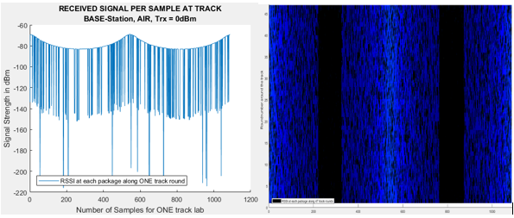
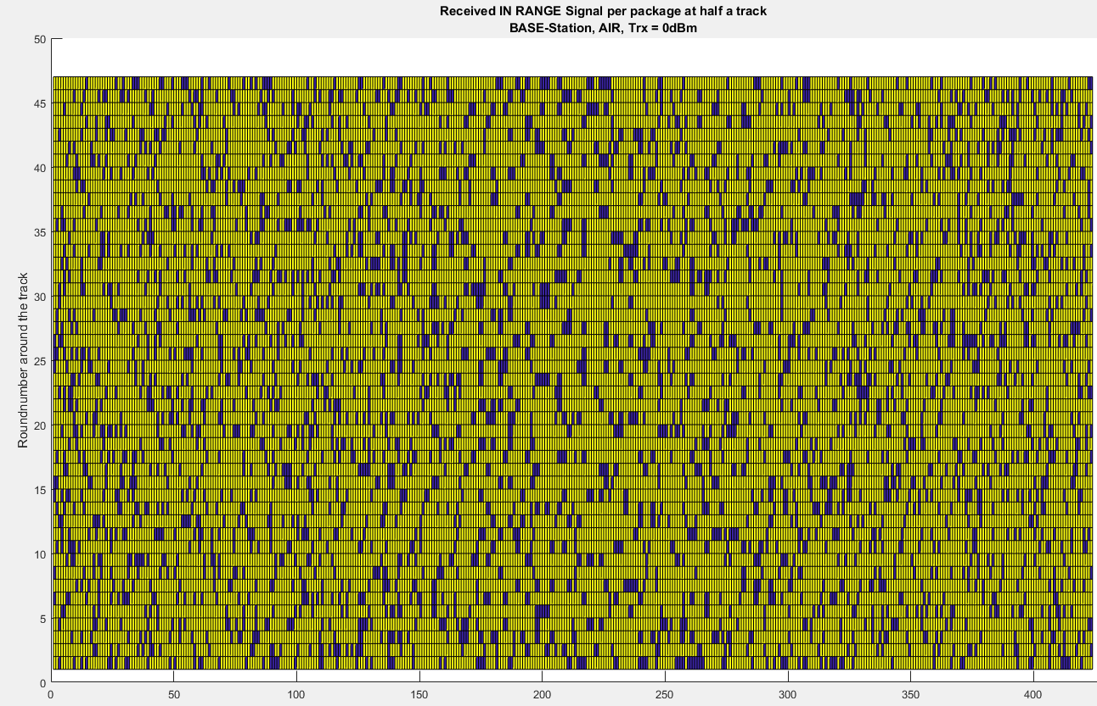
Package Fading
1 lab at the track
-84dBm threshold level
480 packages (4/sec)
Level crossing rate at 0.2
Marathon
47 labs
1087 Packages
IN RANGE direct or relayed package for half a track

Slide 7
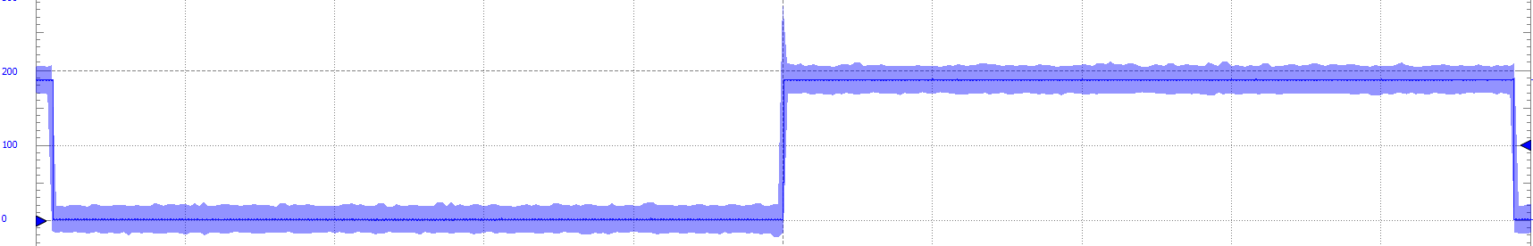
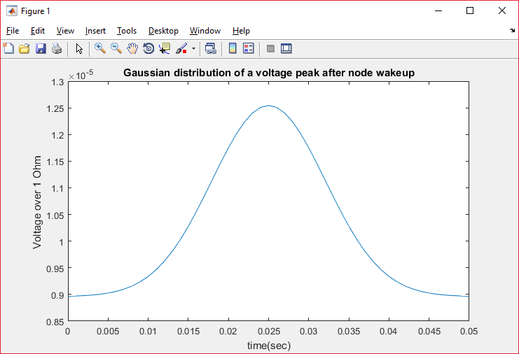
Lifetime Calculations
Overshoot
Radio Off
Radio On
Battery End of Lifetime = Half Capacity
Max and min power transmission
0dBm
-24dBm
Sleep between packages or not
4 packages = 0.0521s
Transmit
Receiving
latency
Overshoot
40% extra power usage at peak
50milli seconds
POWER TABLE
Scenario | Transmission Power | Sleep | Overshoot after wake-up | Base Station Lifetime before half battery capacity (Hours)
1 | Max (0dBm) | No | No | 176,48
2 | Min (-24dBm) | No | No | 176,52
3 | Max (0dBm) | Yes | No | 13101,00
4 | Min (-24dBm) | Yes | No | 13319,00
5 | Max (0dBm) | Yes | Yes | 796,32
6 | Min (-24dBm) | Yes | Yes | 797,11

Slide 8
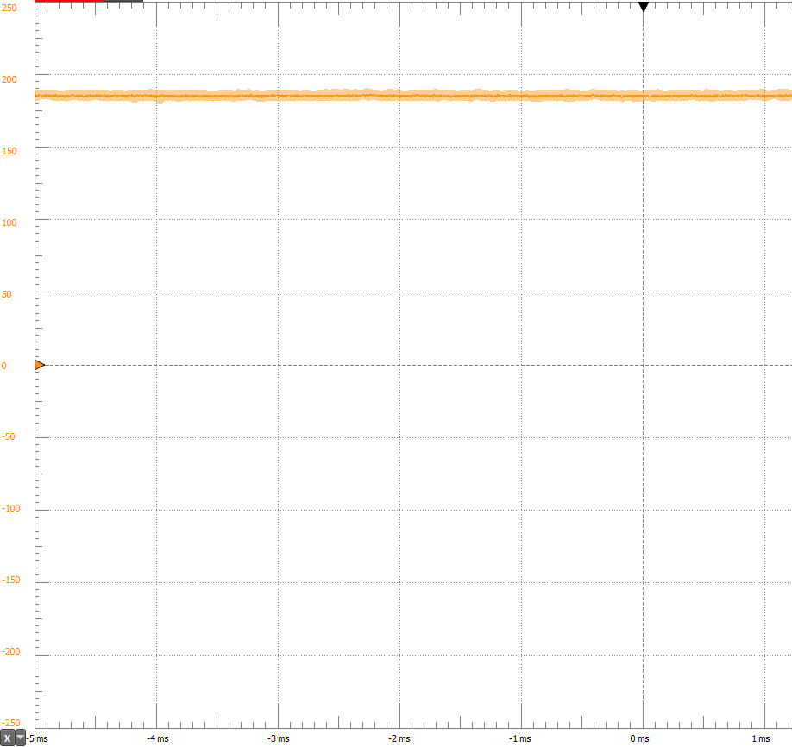
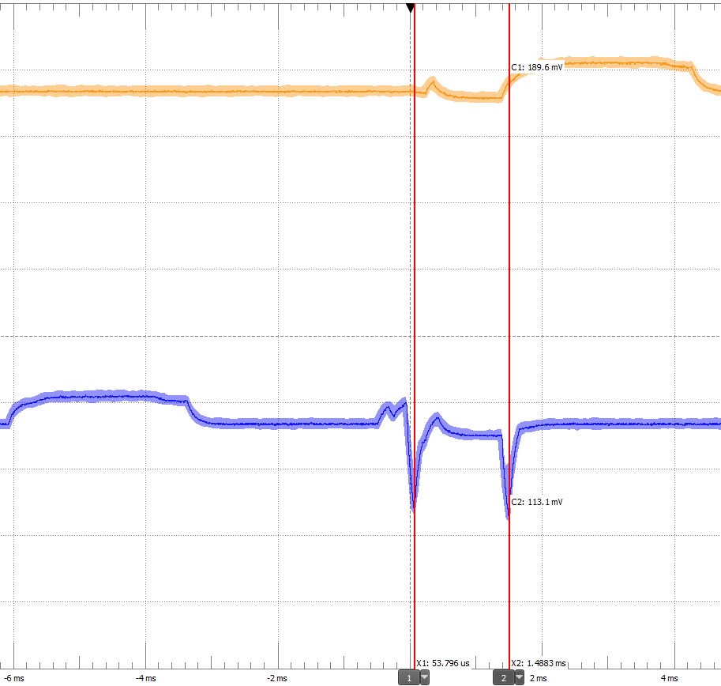
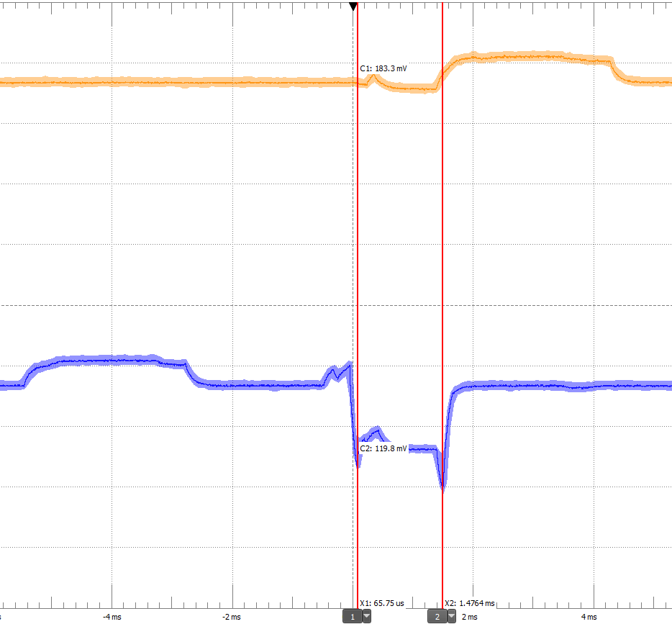
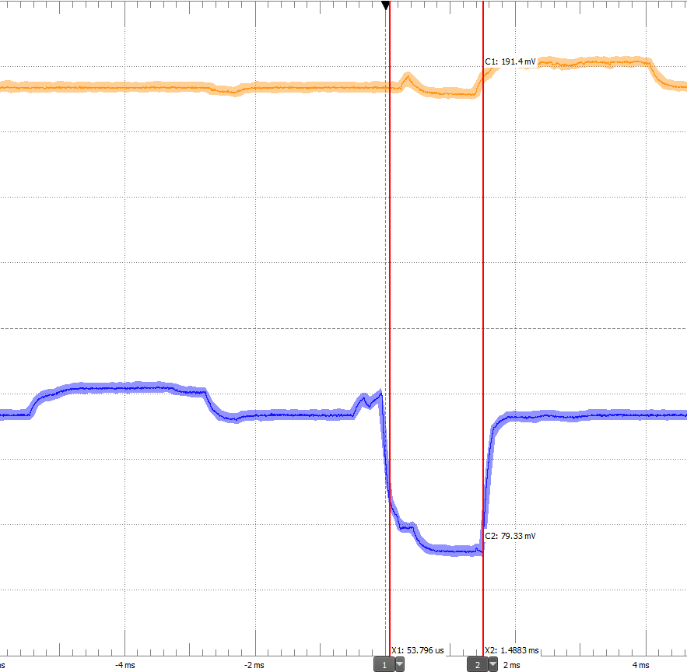
Receive/Transmit Energy
”Idle” Receiving
Transmit with 0 dBm
“Idle” Receiving
18,0 mA
Transmit with 0 dBm
8,0 mA
Transmit with -12 dBm
13,0 mA
Transmit with -24 dBm
17,5 mA
Transmit with -12 dBm
Transmit with -24 dBm

Slide 9
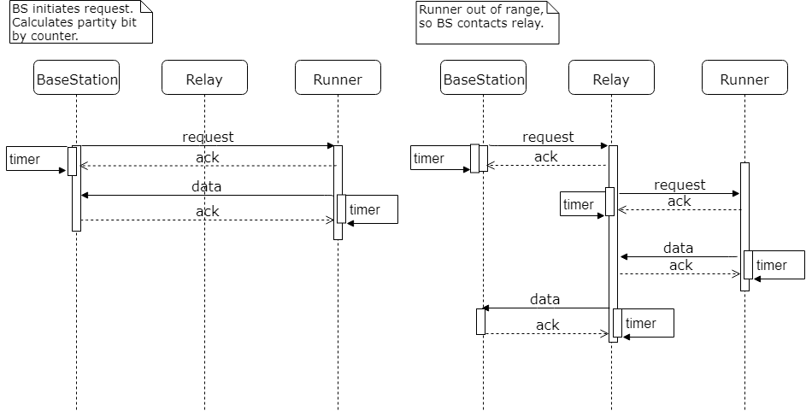
ARQ – stop-and-wait
Scenario 1 and 2 – directly and using the relay
Each request starts a timer – acknowledgment must come before timer runs out
Uses a counter to set parity bit (0 or 1)
Nodes drop a packet if parity bit does not match a counter.

Slide 10
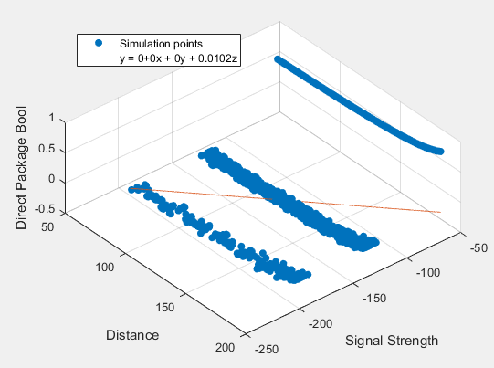
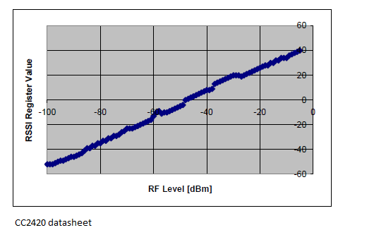
To hop or not – the algorithm
Indicators we used:
Signal strength (RSSI, the RF input power in dbm + 45. Threshold level is -84dBm.
Dropped packets (errors)
History of past events.
Other useful indicators:
Link quality (LQI)
Location of runner

Slide 11

Test scenario (WIP)
Constant speed
In building
-24DBm
47 laps
Different timeout and channels

Slide 12
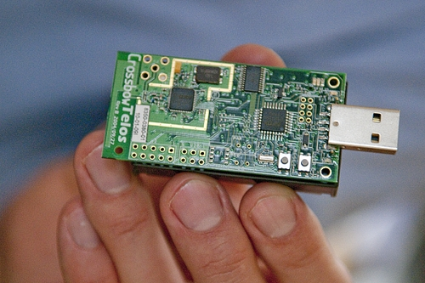
Conclusion
Best to hop when
Out of range
RSSI -40(Deep fading)
RSSI is unreliable
The antenna is expensive battery wise.
Test scenario (WIP)

